Slide 1
Professional Diploma in Commercial Web Design
Lesson 1
MySQL
By Raymond Tsang in Fevaworks
t-raymond.tsang@fevaworks.com

Slide 2
What is a Database
A database is a structured collection of records or data.
A collection of organized information
A computer database relies upon software to organize the storage of data.
Database management systems (DBMS) are the software used to organize and maintain the database.
SQL is the language that access the database.

Slide 3
Why we need a Database
We need to share LARGE AMOUNT OF DATA between users, between tools working on them, and usually between different computers.
Several users and/or several tools must be able to SAFELY ACCESS the same data CONCURRENTLY.
We need persistent storage will last for a long period. This storage must also be RELIABLE.
We need to access to large amounts of data QUICKLY, through indexing and other optimizations.
A DBMS and its data model provides an abstraction; we do not need to care about the physical storage format.

Slide 4
How to connect to a Database
PHP has a connector to all different databases. All you need is to call a function to connect to the database
PHP changed to use mysqli or PDO to connect to DB.

Slide 5
Compare Databases
Microsoft SQL Server
Microsoft SQL Server Express 2016 – 10G, free, good performance, but no UI
Microsoft Office Access – 2G, with easy to use UI and templates
MySQL 5.7 – 4T, free to use, cannot bundle with products
MariaDB
Postgre – free, absolutely free
DB2 – 4G – 9.7
Oracle – 12g R2
EnterpriseDB
MongoDB

Slide 6
Database requirements
Data is the most important thing.
Performance, concurrency, integrity, size limit and recovery from hardware failures are need to considered.
Scale Up - upgrade hardware (RAM, HD) or Scale Out (buy extra server as a grid)?

Slide 7
Data and information
Data is useless
Information is useful
33, 28, 31, 25 is Data
33`C, 28`C, 31`C, 25`C is Information
Database only store Data
We, programmer, use PHP to display data to become the information

Slide 8
Who uses MySQL
Gov’t: NASA, United States Census Bureau,
Web: Yahoo!, flickr, Google, YouTube, facebook, Wikipedia, FOTOLOG, SKYROCK, Craigslist, Digg, Sourceforge, CitySearch,
Travel: SabreHoldings, active hotels, pivex, travelocity, Lufthansa, Continential Airlines, Priceline.com, booking.com
Retail: neckermann.de, GAP, B&Q, axfood, SUZUKI, macy's, spirit group, DaimlerChrysler, caterpillar, texas instruments
Telco: 8x8,Inc., vodafone, Systems, NOKIA, FIVE9, COX communications, Nevis Network, ALCATEL, STANDARD NETWORKS, Earthlink, Ericsson
OEM/ISV: enterasys, JASPERSOFT, QUEST SOFTWARE, symantec, netiQ, CISCO SYSTEMS, sas, Proofpoint
Others: UPS, The associated Press, Hoover’s Online, omaha steaks, HypoVereinsbank

Slide 9
MySQL Price
Oracle now charges $2,000 per server for MySQL Standard Edition support, which doubles to $4,000 for servers with five or more sockets; and $5,000 per server for Enterprise Edition, which also doubles to $10,000 for five-plus sockets.
Oracle has also introduced a Cluster Carrier Grade edition that is priced at $10,000 per server for one- to four-socket servers and $20,000 per server for those with five or more.

Slide 10
MySQL File Size
Operating System | File-size Limit
Win32 w/ FAT/FAT32 | 2GB/4GB
Win32 w/ NTFS | 2TB (possibly larger)
Linux 2.2-Intel 32-bit | 2GB (LFS: 4GB)
Linux 2.4+ | (using ext3 file system) 4TB
Solaris 9/10 | 16TB
MacOS X w/ HFS+ | 2TB
http://dev.mysql.com/doc/refman/5.7/en/table-size-limit.html

Slide 11
Pos of using MySQL
Open source - free to use
Comes with Linux – up to 4G database
Implementation costs only 10-20% of the price of commercial databases (Oracle, IBM, MS)
Capable of handling routine and even critical computing tasks, easy to manage
Usually used for new, custom-built apps
More third-party products now support the open-source database

Slide 12
Cons of using MySQL
Companies have invested in apps that run on commercial databases
MySQL is not highly scalable and lacks triggers, views and stored procedures
Few packaged apps run on MySQL
Big-name software vendors such as peoplesoft, SAP, and Siebel Systems do not support it

Slide 13
Performance
MySQL Database 5.5 delivers enterprise features, including:
Improved! Up to 1500% faster performance on Windows
Improved! Up to 370% faster performance on Linux
Improved! Better scalabilty on modern, multi-core, multi-CPU hardware
New! Performance Schema for monitoring MySQL server run-time performance
New! Semi-synchronous replication to ensure data consistency and redundancy
New! Replication Heartbeat to immediately uncover replication interruptions
New! Partitioning options for faster lookups
New! Easier development and debugging of stored procedures, functions, and triggers

Slide 14
Performance
Reliability requiring little or no intervention to achieve continuous uptime
Ease of use with "15 minutes to success" installation and configuration
Low administration with very little database maintenance required
Replication providing flexible topologies for scale-out and high availability
Partitioning to improve performance and management of very large database environments
ACID Transactions to build reliable and secure business critical applications
Stored Procedures to improve developer productivity
Triggers to enforce complex business rules at the database level
Views to ensure sensitive information is not compromised
Information Schema to provide easy access to metadata
Pluggable Storage Engine Architecture for maximum flexibility

Slide 15
Site
http://www.mysql.com (Eng)
http://dev.mysql.com/doc/ (Manual)

Slide 16
How large can MySQL handle
60000 tables
5 billion rows
8 million terabytes in some system

Slide 17
Create a Database
We seldom have a chance to use command prompt to control our database. Moreover, it’s too dangerous for an end user to have too much rights/control.
We use phpMyAdmin to control a database.
http://localhost/phpmyadmin
http://localhost:8080/phpmyadmin

Slide 18
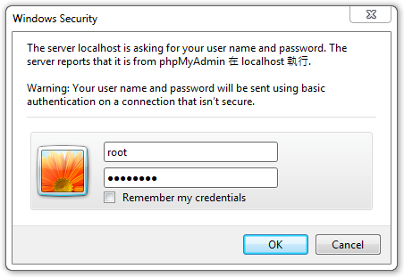
Login
http://localhost/phpmyadmin/
Username: root
Password: password

Slide 19
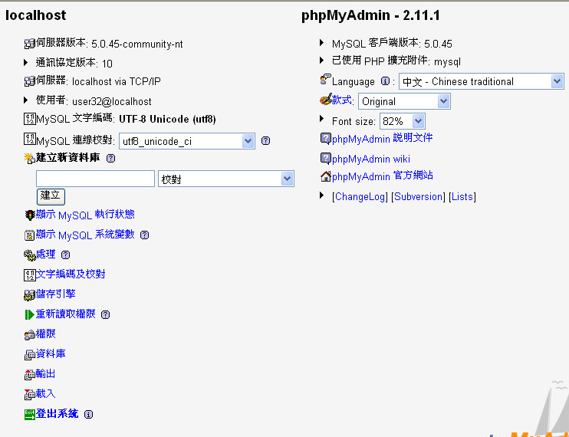

Slide 20
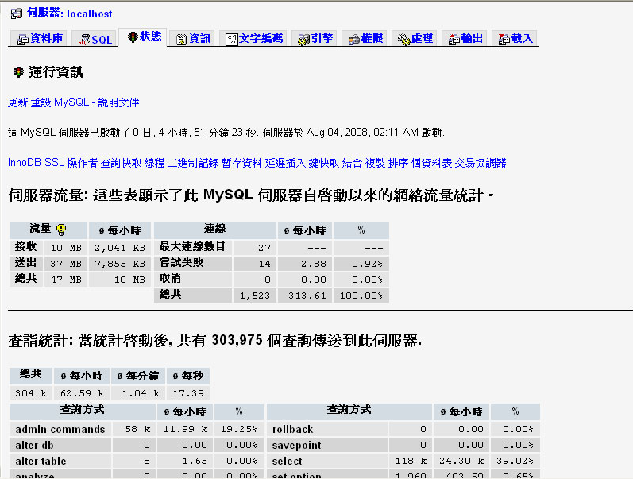

Slide 21
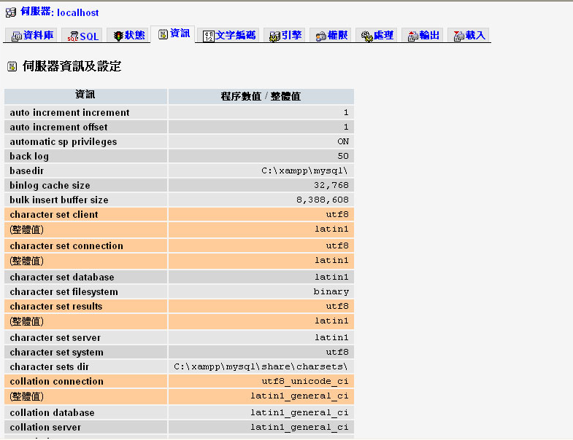

Slide 22
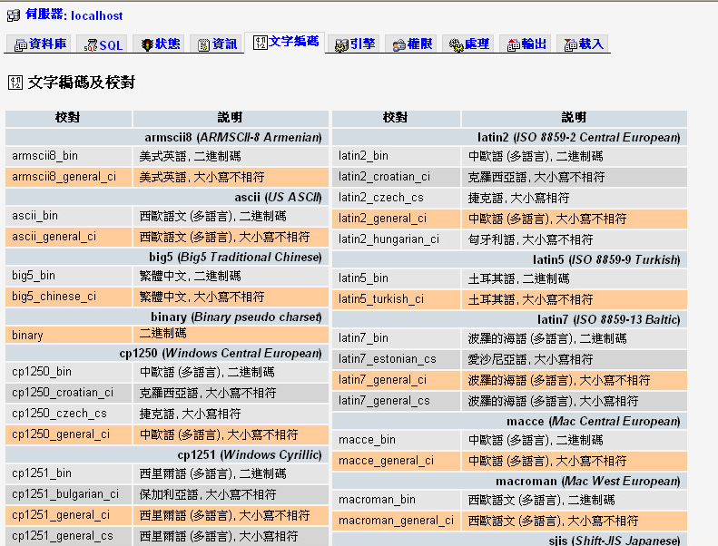

Slide 23
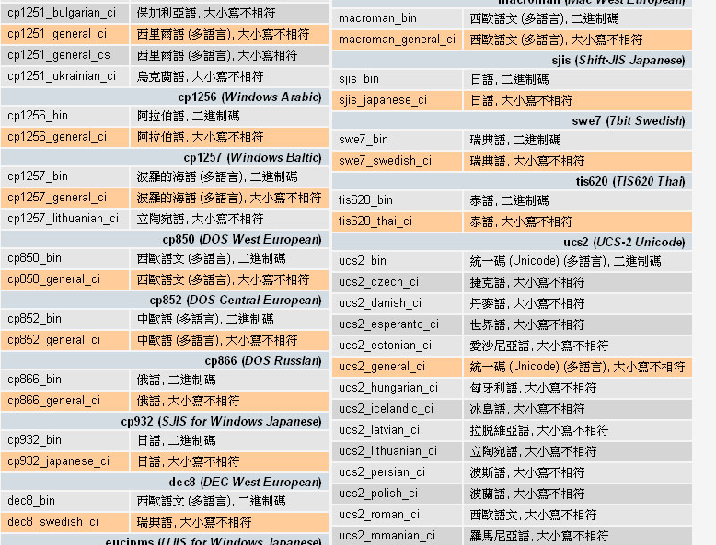

Slide 24
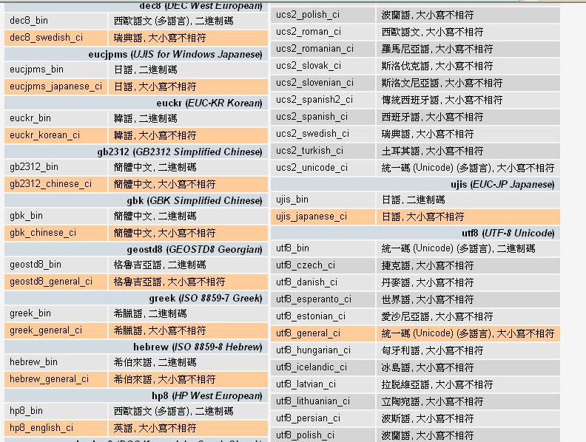

Slide 25
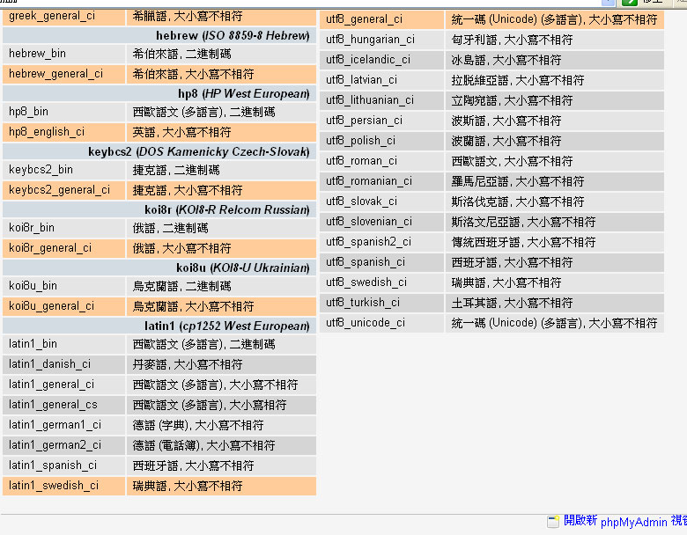

Slide 26
Character set
A character set is a set of symbols and encodings.
Unicode is the most common way for character set.
UTF-8 -> utf8_general_ci

Slide 27
Uni-code
MySQL 5.0 supports two character sets for storing Unicode data:
ucs2, the UCS-2 encoding of the Unicode character set using 16 bits per character
utf8, a UTF-8 encoding of the Unicode character set using one to three bytes per character
They usually include a language name, and they end with _ci (case insensitive), _cs (case sensitive), or _bin (binary).

Slide 28
Collation
A character set is a set of symbols and encodings. A collation is a set of rules for comparing characters in a character set..
Suppose that we have an alphabet with four letters: “A”, “B”, “a”, “b”. We give each letter a number: “A” = 0, “B” = 1, “a” = 2, “b” = 3. The letter “A” is a symbol, the number 0 is the encoding for “A”, and the combination of all four letters and their encodings is a character set.
Suppose that we want to compare two string values, “A” and “B”. The simplest way to do this is to look at the encodings: 0 for “A” and 1 for “B”. Because 0 is less than 1, we say “A” is less than “B”.

Slide 29
Database and Excel
Excel | Database
xlsx | Left nav
Sheet | Table
Row | Record
Column | Field
Cell | Value

Slide 30
Schemas
complete set of table design
test (id, message)
Shows each data types of a column and indicate the primary key(underline)
Primary key is the unique key in the table
Eg. HKID is primary key, so there are many people can use your name but no one else can have the same HKID as you.

Slide 31
Steps to create database
Create database
Create table
Create fields

Slide 32
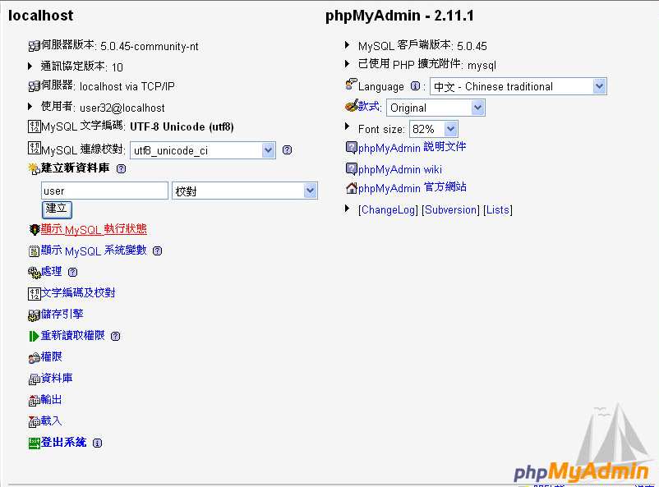

Slide 33
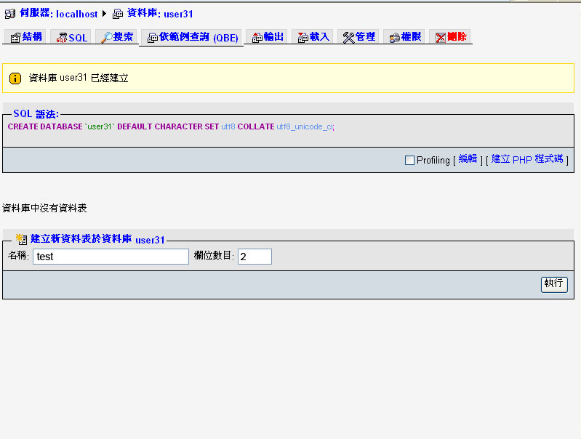

Slide 34
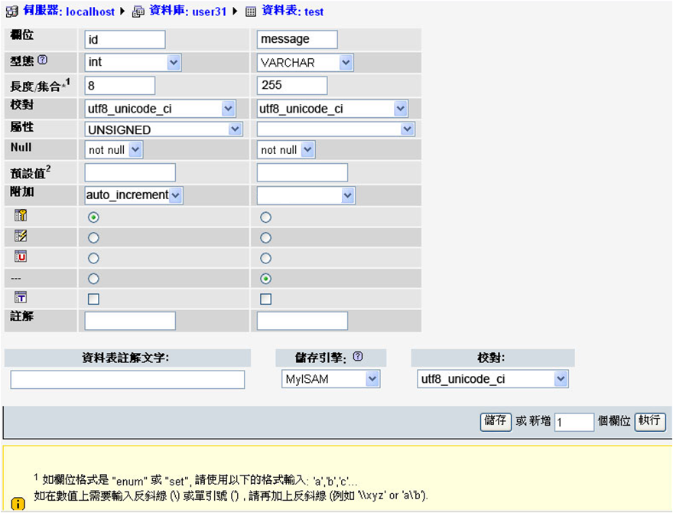

Slide 35
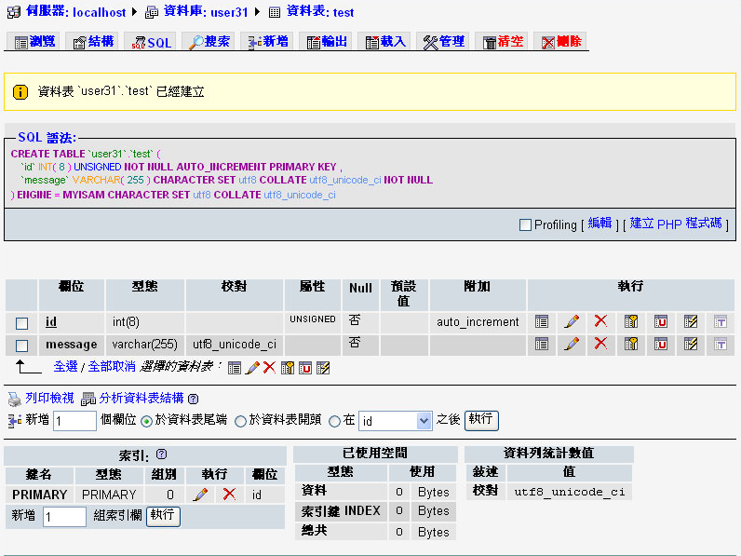

Slide 36
int
Type | Storage | Minimum Value | Maximum Value
 | (Bytes) | (Signed/Unsigned) | (Signed/Unsigned)
TINYINT | 1 | -128 | 127
 |  | 0 | 255
SMALLINT | 2 | -32768 | 32767
 |  | 0 | 65535
MEDIUMINT | 3 | -8388608 | 8388607
 |  | 0 | 16777215
INT | 4 | -2147483648 | 2147483647
 |  | 0 | 4294967295
BIGINT | 8 | -9223372036854775808 | 9223372036854775807
 |  | 0 | 18446744073709551615

Slide 37
Decimal number
Fixed-Point Types (Exact Value) - DECIMAL, NUMERIC
Floating-Point Types (Approximate Value) - FLOAT, DOUBLE 0.001=0

Slide 38
Create table
var：不定長度→ n+1
char宣告的是固定的長度，因此如果宣告char(5)，但是只放a這個字，那麼就會補另外4個空白，會補空白補滿是他的特性
varchar是不定長度，因此如果宣告varchar(5)，但是只放a這個字，那麼就會放一個a，不會補空白。

Slide 39
CREATE TABLE `test` (
`id` int(10) unsigned NOT NULL auto_increment,
`message` varchar(140) default NULL,
PRIMARY KEY (`id`)
) ENGINE=MyISAM DEFAULT CHARSET=utf8

Slide 40
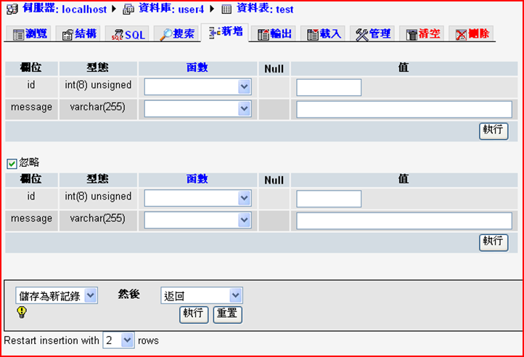
INSERT

Slide 41
INSERT
Field | Type | Function | Null | Value
id | int(8) unsigned
message | varchar(255) |  |  | Hi
id | int(8) unsigned
message | varchar(255) |  |  | How are you?
id | int(8) unsigned
message | varchar(255) |  |  | I am fine
id | int(8) unsigned
message | varchar(255) |  |  | Great!
Add 10 more records

Slide 42
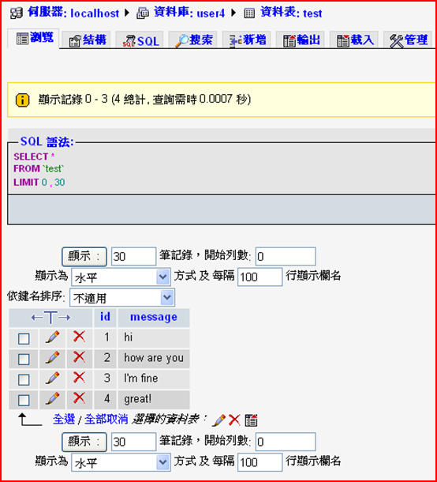
Browse / Query

Slide 43
Update
Click the pencil icon to update the record

Slide 44
Delete
Click the cross icon to delete the record

Slide 45
Homework
Create a table for member registration

Slide 46
QUESTIONS

